Slide 1

Keys to EIV Income Discrepancies
North Tampa Housing Development Corporation
SAHMA – Florida Conference
Wednesday 4/19/2023
Notes:
Welcome

Slide 2
Session Speaker
Dorothy Swayze
Local Services Manager
North Tampa Housing Development Corporation
  Contact Information:
  CGI Federal/NTHDC
  Phone: (813) 554-1264
  Email: dorothy.swayze@cgifederal.com

Slide 3









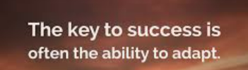



What is the Key to Success

Slide 4

What is the Focused Key to Success for EIV Income Discrepancies
  Printing EIV Reports is only half the battle, the KEY to SUCCESS is knowing how to interpret, utilize, and investigate the information on the reports!
EIV Income
Discrepancies

Slide 5

Session Objectives
  Obtain the keys to success for dealing with EIV income discrepancies
  By Learning:
  How to read and interpret the information reported on EIV Income Report and EIV Discrepancy reports
  How to identify, investigate, and resolve discrepancies
  How to properly document the EIV reports and tenant files with required information
By gaining an understanding that it is not just about the Income Discrepancy report, the Income Report also must be reviewed for discrepancies to be successful

Slide 6
Important Tidbits to Remember
  Correct failed verifications and
  statuses:
  There will be no income information in EIV for a tenant or specific member of the household if the following are unresolved:
  Failed Pre-Screening Report Discrepancies
  Failed Verification Report Discrepancies
  Failed Summary Report Status
  Follow up on and make corrections for all tenants listed on the New Hire Report in EIV.
  Why is this important?
  Unresolved new hires will eventually result in income discrepancies if the tenant actually starts working and makes and wages result in more than $200 as month.

Slide 7
Important Tidbits to Remember
  All errors listed on the Failed Pre-Screening* and Failed Verification Reports, all Failed Statuses on the Summary Report, and all new hires listed on the New Hire report need to be followed up on and corrected within ______ Days of each of these reports being run.
  30 Days
  * Some things on the pre-screening have a longer timeframe such as members under 6 added without a SSN, then there is a 90 day window in which the tenant has to provide the SSN.

Slide 8
More Tidbits to Remember
  Run Income, & Discrepancy Reports Timely
  Summary, Income, and Discrepancy reports are automatically generated each time the Income Report is run in EIV
  System searches for available personal identifiers and income data for each member and matches that data to information listed on the last 50059 submitted to TRACS
  Must generate these reports within 90 days after MI or IC 50059 submission to TRACS
  Must generate these reports at each AR & IR (and other times if so outlined in O/A procedures)
  HUD Handbook 4350.3 Chapter 9, 9-11 A, B, and C. provides guidance on how to use these reports

Slide 9
Income Report
Income Report
Income Report includes information for each household member for:
    Wages
      Including New Hire Information
    Unemployment benefits
    Social Security benefits
      SS, SSI, Dual Entitlements, and Medicare

Slide 10
Income Report
Income Report will not have information on income from other sources such as:
Child Support
Welfare
Family Contributions
Pensions
Income from Assets

Slide 11
Income Report
Wages
Information is updated quarterly - approximately 1 to 2 months after the end of the calendar quarter
Income Report is 3rd party verification that tenant is employed but cannot be used to calculate the income
Must obtain 4 consecutive, recent paystubs from tenant to calculate income
Why is it important to be aware of when EIV updates income information?

Slide 12
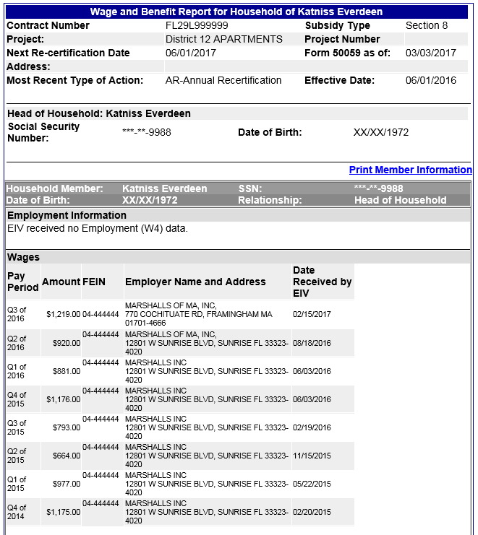
Income Report - Wages
You have run the report, what now?
Review the report
Compare report wage information to what was reported by the tenant
Compare past wage information on the report to wage information on past 50059s and the file
Notify and speak with tenant
Obtain any needed verifications
Process any corrections and/or retroactive IRs
Process any necessary repayment agreements

Slide 13
Income Report - Wages
Important Information:
Last certification type and effective date listed in TRACS
Member with wages and relationship to the HOH
New Hire Information
Wages paid for the last 8 quarters

Slide 14
Income Report - Wages
This report was run when processing the 2017 AR. If this tenant’s 6/1/2016 AR had wage income and verification from Marshalls is in the file, is there anything else to check?
Yes

Slide 15
Income Report - Wages
Income goes back to at least Q4 of 2014, so need to double check the file and make sure all certifications processed since then includes this income

Slide 16
Income Report - Wages
What if the 1st time this income appears on the 50059 is with the 2015 AR, is that ok?
No – income was being received well prior to the 6/1/2015 AR, it started in at least 2014.

Slide 17
Income Report - Wages
So if this income only 1st appeared on the 2015 AR, what corrective action needs to be taken?
Verify start date and amounts received
Process corrections and IRs as needed to add the portion that was unreported
Process Repayment Agreement

Slide 18
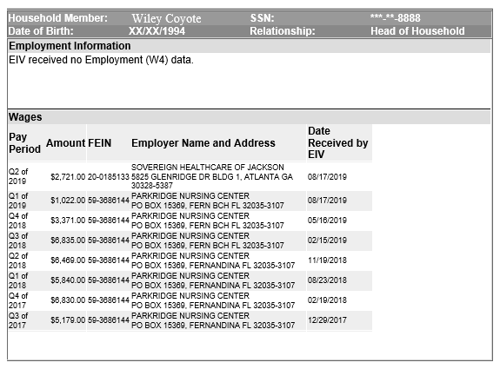
Income Report - Wages - Practice
What is this income report telling you?
What would expect to see in the tenant file?

Slide 19
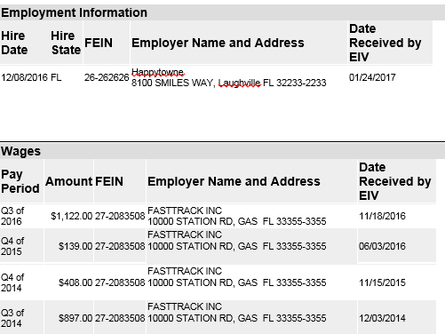
Income Report – Wages - Practice
What is this income report telling you?
If this EIV Report was run for a 7/1/2017 AR, what would you expect to see in the file?

Slide 20
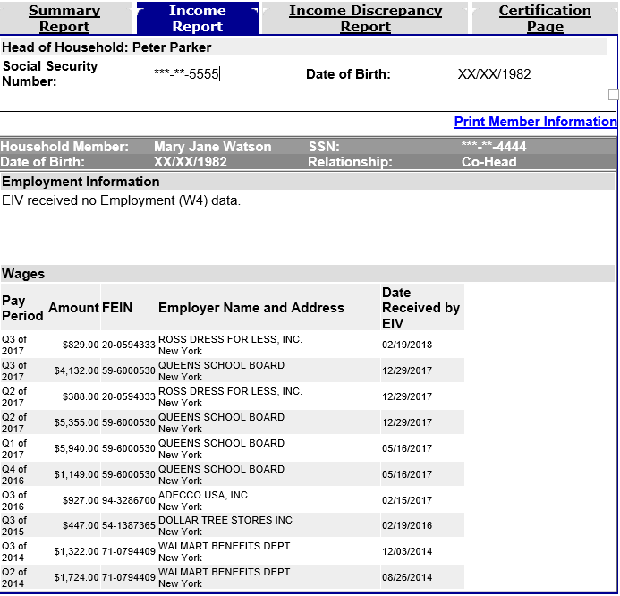
Income Report – Wages - Practice
What is this income report telling you?
Why would this report not show a new hire even though the quarterly wages seem to show a new job?

Slide 21
Income Report – Wages - Practice
What would you expect to see in the file?

Slide 22
Income Report – Wages - Practice
Will this Ross income result in a income discrepancy report when EIV is run for a 3/1/2018 AR and no IR’s have been done since last AR?
Why or why not?
This is why it is important to review the income report in detail.

Slide 23
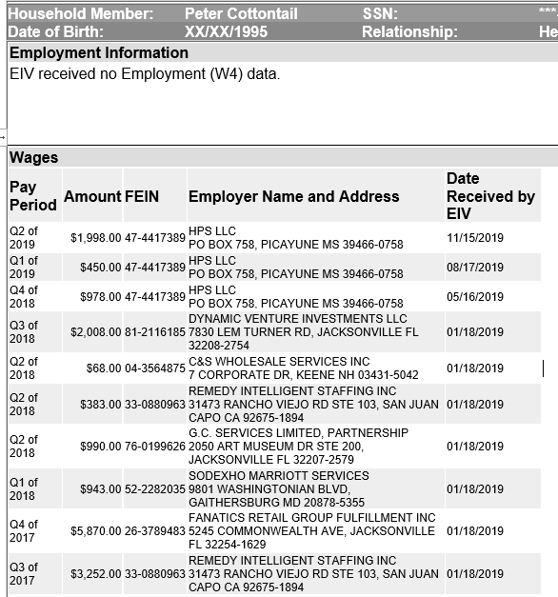
Income Report – Wages - Practice
Income Report run for 2/1/2020 AR:
Last Certification was an AR on 2/1/2019 with no wage income
Certification before that was an IR 6/1/2018 to remove wage income
MI was 02/25/2018 with wage income
Are there any issues?

Slide 24
Verification Tidbits to Remember when reviewing the Income Report
Obtain traditional 3rd party verification of employment if:
Tenant insists they are not employed, but wage information is listed in EIV
Tenant reports recently gaining or losing a job
Tenant reports they are working but no wage information is in EIV
Tenant is unable to provide the required paystubs
  Do not wait for the tenant to accumulate 4 check stubs before processing the IR

Slide 25
Income Report – Unemployment
Unemployment Benefits
Information is updated quarterly - approximately 1 - 2 months after the end of the calendar quarter
EIV serves as 3rd party verification that tenant is receiving unemployment benefits, but EIV cannot be used to calculate income
Must obtain 4 consecutive benefit “paystubs” or benefit letter from tenant to calculate income

Slide 26
Important Tidbits to Remember
  During COVID there were some supplemental
  unemployment payments that were considered income and some that were to be excluded from income.
  Where can this guidance be found?
  Questions and Answers for Office of Multifamily Housing stakeholders Coronavirus Disease 2019
  What Unemployment payment was counted and what was not counted?
  Regular Unemployment payments IS counted.
  Pandemic Unemployment Assistance (PUA) IS counted
  Federal Pandemic Unemployment Compensation (FPUC) IS NOT counted
  Pandemic Emergency Unemployment Compensation (PEUC) IS counted
  What timeframe is affected:
  2020 through end of 2021

Slide 27
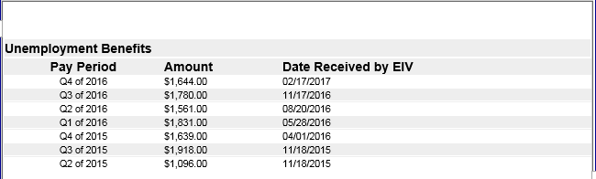
Income Report - Unemployment
Review the report
Compare report Unemployment information to what was reported by the tenant
Compare past unemployment information to wage information on past 50059s
Obtain any needed verifications
Process any corrections and/or retroactive IRs
Process any necessary repayment agreements

Slide 28
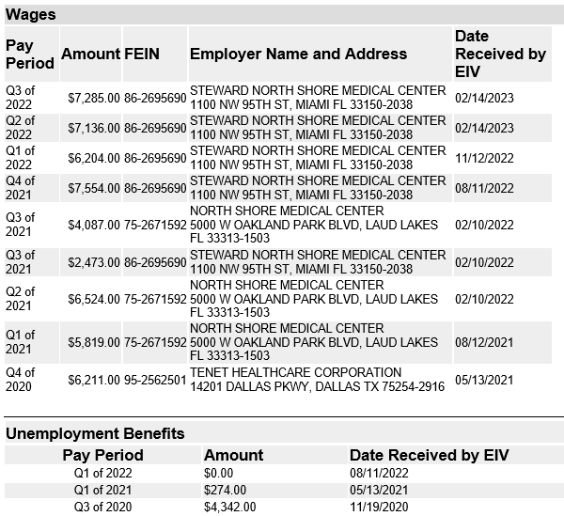
Income Report - Unemployment
What is this income report telling you?
What do we need to lookout for with this unemployment?

Slide 29
Income Report - Unemployment
If MI was 4/1/2020 and this report was run during the 4/1/2023 AR, What would you expect to see in the file?
Verification and IR in 2020 with Unemployment from Q3 2020
Verification and IR 2020 with wages from Tenet Healthcare in Q4 2020
Verification and IR for end of job and addition of unemployment in Q1 2021
Verification and IR for new job North Shore in Q1 2021
Verification and AR 2021 with wages matching EIV info for North Shore
Verification and IR in Q3 2021 for possible wage increase more than $200 when started with Steward North Shore
Verifications and AR with wages from Steward

Slide 30
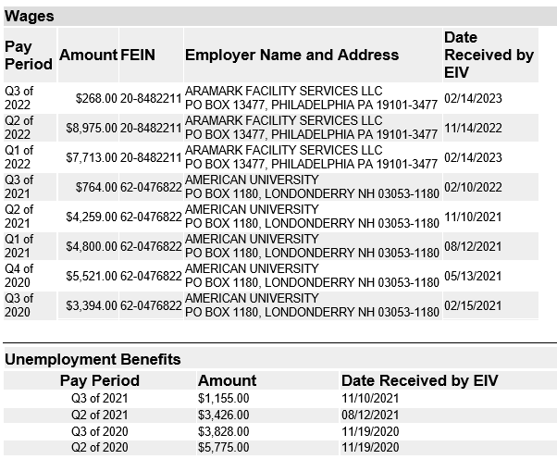
Income Report – Unemployment - Practice
What is this income report telling you?
What do we need to look out for with this unemployment?
If MI was 4/1/2021, what would you expect to see in the file?

Slide 31
Verification Tidbits to Remember when reviewing the Income Report
Obtain traditional 3rd party verification of Unemployment Benefits if:
Tenant insists they are not receiving unemployment, but benefit information is listed in EIV
Tenant reports they are receiving unemployment, but no benefit information is in EIV
Tenant is unable to provide documentation

Slide 32
Income Report – Social Security
Social Security Benefits
Information is updated quarterly - approximately 1 to 2 months after the end of the calendar quarter
EIV serves as third party verification and can be used to calculate annual income from SSA benefits as long as the tenant agrees with the information
SSA COLA is not available in EIV until the end of the calendar year

Slide 33
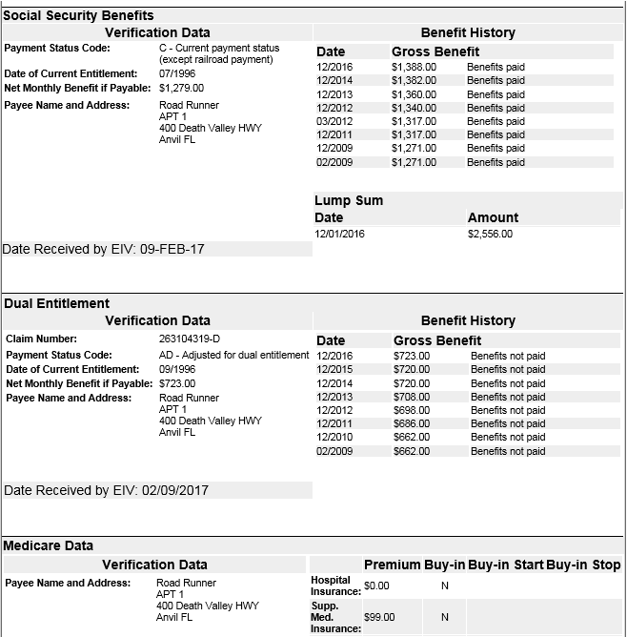
Income Report – Social Security
Important Information:
Gross and net amounts currently being received
Benefit type
Medicare Information
Based on the available information in EIV, is there enough information to calculate income and deductions from Medicare?

Slide 34
Income Report – Social Security
What is this report Telling you?
Gross Benefit $1388
Net Benefit $1279
$1388-$1279 = $109
Medicare $99
Unaccounted difference of $10
What, if anything needs to be done?
Verify what the $10 difference is for. And how to account for it. It could be an RX plan payment being deducted or an overpayment in benefits being deducted, or child support garnishment.

Slide 35
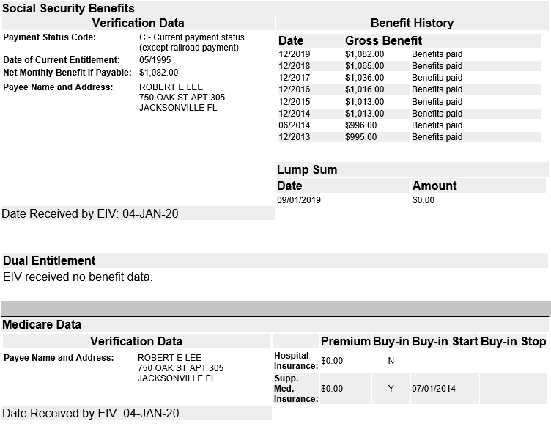
Income Report – Social Security – practice
What is this report Telling you?
What would need to be in the file?

Slide 36
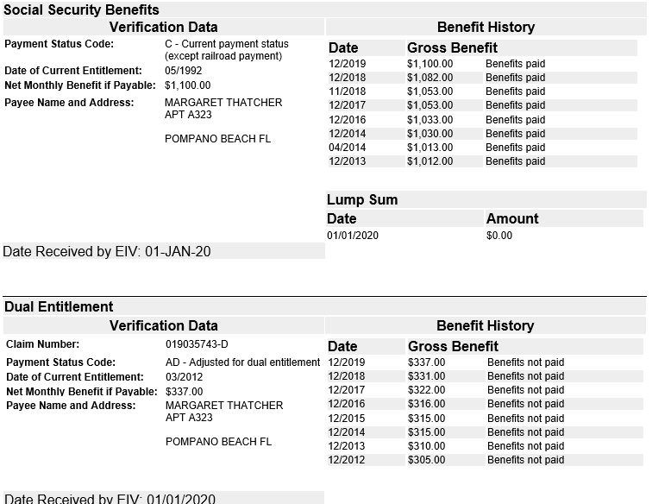
Income Report – Social Security – practice
What is this report Telling you?
What would need to be in the file?

Slide 37
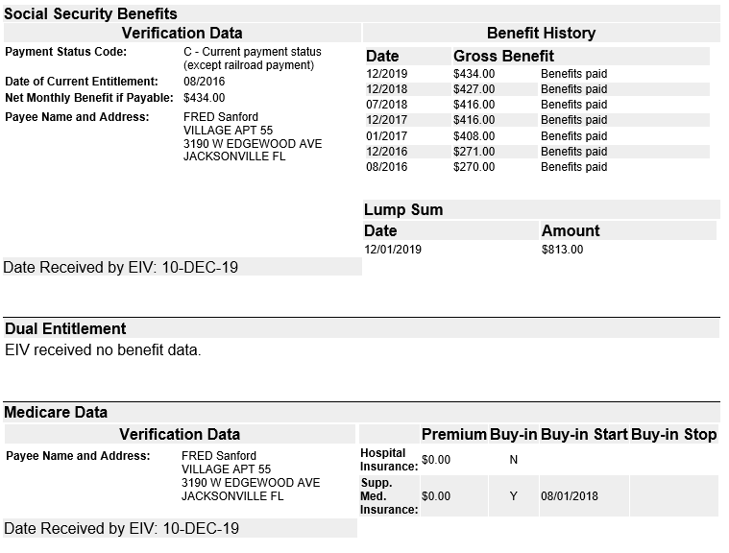
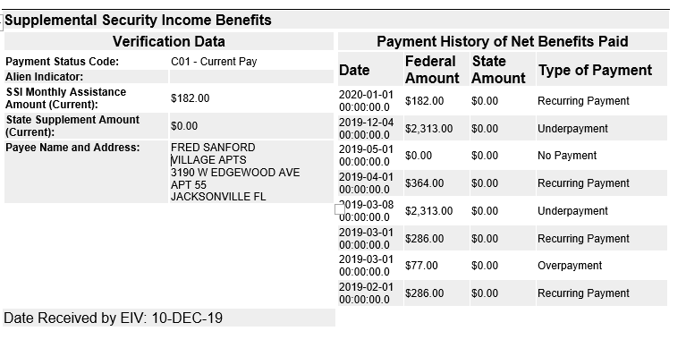
Income Report – Social Security – practice
What is this report Telling you?
What would need to be in the file?

Slide 38
Verification Tidbits to Remember when reviewing the Income Report
Obtain traditional 3rd party verification of SSA Benefits if:
Tenant disagrees with information in EIV
The difference between the gross benefit and the net benefit cannot be explained by Medicare amount that is listed in EIV
EIV will not have information on Medicare Part D (prescription drug plan)
If tenant reports paying for Part D, additional verification is required
Tenant may have garnishments or amounts for an overpayment being withheld

Slide 39
MOR Tidbits regarding the Income Report
Common issues found during an MOR regarding
the discrepancies with the Income Report:
Not following up on possible unreported or underreported income (report run and placed in the file but not reviewed)
Not maintaining documentation of all follow up actions (notices, verifications, and corrections)
How to avoid these types of findings:
Provide initial and in-depth training to site staff when to run the report as well as how to review the report, compare to reported information in the file, and take any necessary follow up action within 30 days (notice, verification, correction, repayment agreement, etc.)
Provide regular refresher training on EIV and how to read, interpret, and follow up on EIV reports a few times a year.
Have regional managers do spot checks several times throughout the year to ensure EIV is being used and properly reviewed and followed up on.

Slide 40
Income Discrepancy Report
Income Discrepancy Report
Must be printed and maintained each time the Income Report is printed and maintained even if no discrepancies are listed
EIV compares the income from the 50059 with income reported from NDNH and SSA
An Income Discrepancy will be reported if the annual income in TRACS is different from the actual or annualized income in EIV by more than $2400 per year (higher or lower) for the period of income listed on the report

Slide 41
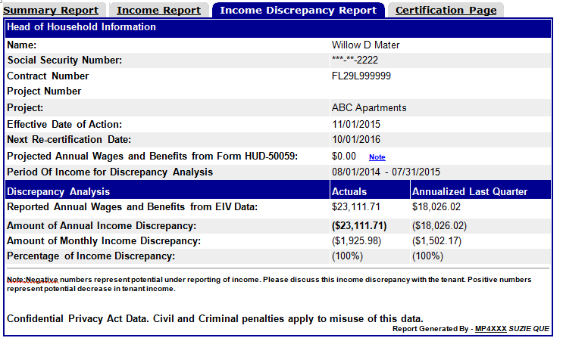
Income Discrepancy Report
You have run the reports, what now?
Important information:
50059 being analyzed
Income from 50059
Period of Income (POI)
Reported actual annual income
Reported annualized income from last quarter
Annual and monthly discrepancy

Slide 42
IMPORTANT Tidbit Regarding the Income Discrepancy Report
What is the Period of Income (POI)?
The period of income (POI) will be a 12 month period beginning 15 months prior to the effective date of the last 50059 in TRACS
  The Income Discrepancy Report is analyzing the income that was listed on the last 50059 which may be almost a year old when this report is run
  This report is not analyzing the income for the recertification you are currently processing

Slide 43
IMPORTANT Tidbit Regarding the Income Discrepancy Report
  Why is this odd timeframe the the period of income (POI) used by EIV?
  The recertification period starts 120 days prior to the anniversary date, verifications at all certifications (MI, IC , IR, and AR) cannot be more than 120 days old; so the verifications obtained for the last recertification were obtained 1 to 4 months prior to the actual effective date lining it up about with the end of the POI timeframe EIV uses.

Slide 44
Income Discrepancy Report
What is this report saying?
From 8/1/14-7/31/15 reported income in EIV was $23,111.71
The income from the last quarter of 8/1/14-7/31/2015 annualized was $18.026.02
Last 50059 effective 11/1/2015 $0 was reported as income

Slide 45
Income Discrepancy Report
How do you interpret this information?
    There is possible unreported income that needs to be investigated to determine if there is a valid discrepancy because:
      In the 15 months prior to the last certification the tenant was receiving income
      At the time of the certification the tenant reported $0 income
    Is this enough information to determine if this is a valid discrepancy? No
    What are some reasons why this discrepancy may have been generated?
    Job was reported, verified, and included on prior 50059s, but ended prior to the last certification, so this is a false positive
    Tenant was still working at that time of the last certification but did not report it, so this is unreported income

Slide 46
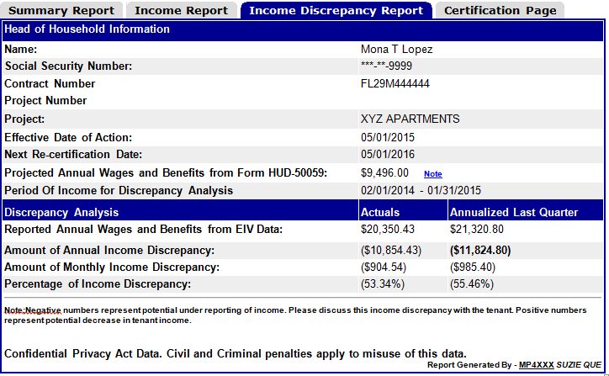
Income Discrepancy Report – Practice
What is this report saying?

Slide 47
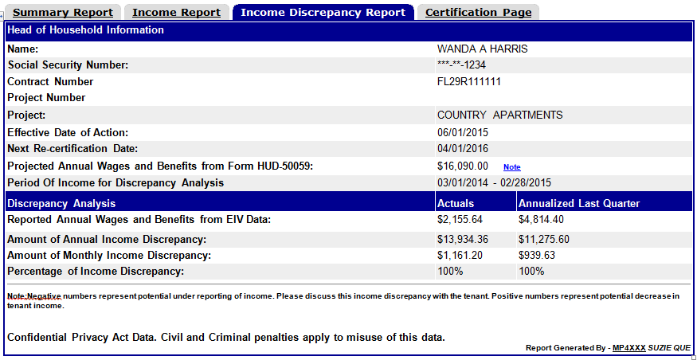
Income Discrepancy Report – Practice
What is this report saying?

Slide 48
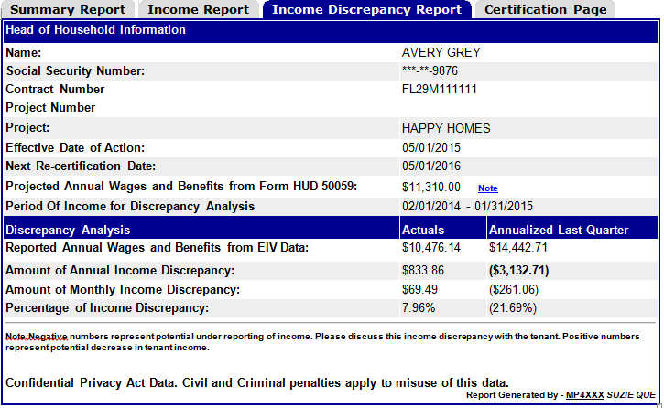
Income Discrepancy Report – Practice
What is this report saying?

Slide 49
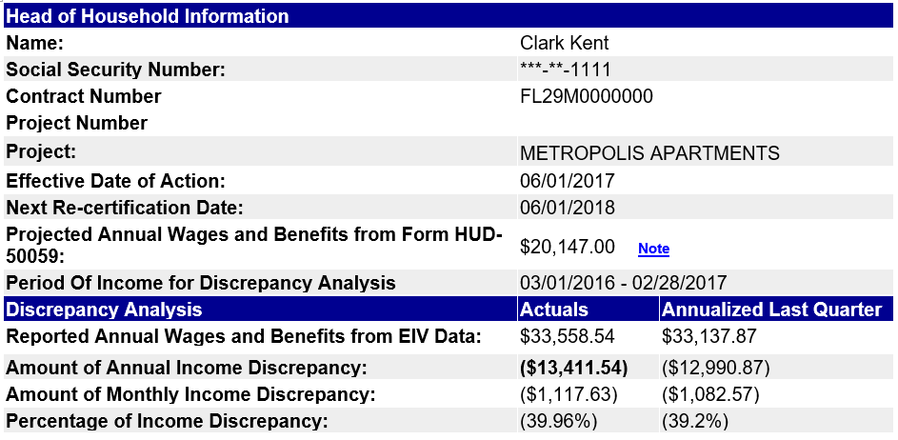
Income Discrepancy Report – Practice
What is this report saying?
Are these notations acceptable?
Why or Why Not?
N/A period reviewed was prior to MI

Slide 50
What to do when Income Discrepancy
Report is Generated
A discrepancy was listed on the Income Discrepancy Report, now what?:
Within 30 days from the date of the report review and resolve the discrepancy
  Determine if the listed discrepancy is an O/A error (calculation), tenant error (unreported/underreported), or false alarm
    Review the file, verifications, and 50059(s)
    Check for verification, miscalculation, or data entry errors
    If necessary, send notice to tenant and discuss the possible discrepancy with them
    If necessary, obtain 3rd party verification - required if unreported/underreported income

Slide 51
What to do when Income Discrepancy
Report is Generated
    2. Notate the report with actions taken including explanation why a discrepancy may be a false positive
    3. Maintain Income Discrepancy Report with notations in the tenant file along with documentation of all follow up action taken to resolve possible unreported or underreported income including contact with tenant, verifications, corrected/additional 50059s, repayment agreement, additional file notes etc.

Slide 52
What to do when Income Discrepancy
Report is Generated
How do you investigate?
You must determine if the discrepancy is valid or invalid and what additional information may be needed. Start by:
  Reviewing the Income Discrepancy Report
      Read and interpret the listed information
    Reviewing the Income Report to determine what income EIV indicates the tenant was receiving at the time of the POI and last certification
Remember one of our objectives for today was gaining an understanding that it is not just about the Income Discrepancy report, the Income Report also must be reviewed for discrepancies to be successful

Slide 53
Sidebar on how The Income Discrepancy Report and Income Report work together
Income Discrepancy Report
Income Report
Unlocks a bigger picture

Slide 54
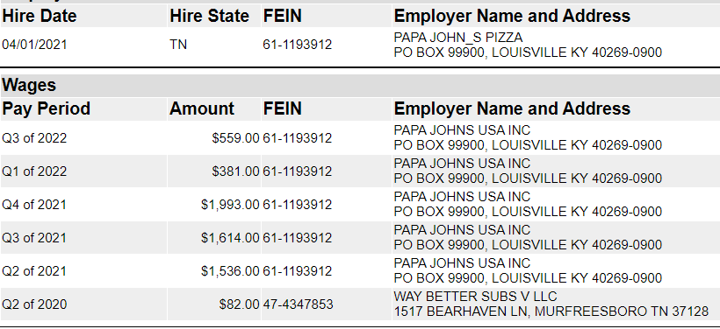
Connecting the Dots Between Income Report and Income Discrepancy Report
Scenario: This income report was run during 3/1/2023 AR processing and a discrepancy was generated
    The discrepancy report listed the last certification as 3/1/2022 with $0 income, annual discrepancy $5143, and last quarter annualized $7972. POI was 12/1/2020 - 11/30/2021.
    Looking at the income report above, can you determine why this discrepancy may have generated?
    EIV is showing a break in income from Papa Johns from some time in Q1 2022 with no wages reported in Q2 2022.

Slide 55
Connecting the Dots Between Income Report and Income Discrepancy Report
    What would you expect to see in the file?
    Verification at 3/1/2022 AR or some time in Q1 2022 showing date employment ended
    Verification for Papa Johns start date and wages earned
    IR with effective date corresponding to around the time the income started (EIV shows hire date of 4/1/2021 which is after the 2021 AR, and the increase was increase more than $200 a month).
    What should the note be on the discrepancy report?
    Notes should be something like: Tenant quit just prior to AR, verification obtained during last AR.
Bonus Question: What determines the effective date of the IR?

Slide 56
Taking it a Step Further with the Income Report
    In this scenario we determined the income discrepancy was a false positive, but is that it? Remember it is not just about the income discrepancy report and the last certification, additional discrepancies may be present if income on the Income Report does not match the 50059s and tenant reported information in the file.
    So, what if there was no IR in the file corresponding to the job start date, what then?
    This is now unreported income, so verification for Papa Johns start date and wages earned must be obtained
    IR with effective date retroactive to the 1st of the month after the job began must be processed, and possibly an IR to remove the wages.
    Repayment agreement executed with the tenant

Slide 57
Connecting the Dots Between Income Report and Income Discrepancy Report
New Scenario: This income report was run during 10/1/2022 AR processing and a discrepancy was generated
    The discrepancy report listed the last certification as 10/1/2021 with $0 income, annual discrepancy $1536, and last quarter annualized $6144. POI was 7/1/2020 - 8/31/2021.
    EIV Income report is showing unreported income from the time of that 10/1/2021 AR, notice needs to be sent, verifications obtained, corrections and any necessary IRs processed, and Repayment agreement done.
    Note would be something like: Tenant did not report new job at last AR. Verifications and corrections have been done.

Slide 58
What to do when Income Discrepancy
Report is Generated
  After reviewing the Income Discrepancy and Income Reports:
  Review the tenant file documentation
      The 50059 for which the Income Discrepancy Report was generated
      Tenant reported information for that certification
      Income verifications for that certification
      If necessary, 50059s and income verifications for prior certifications as well (up to 5 years)
      Look at the 50059 and compare it to the information reported by the tenant, verifications in the file, and the information on the Income Discrepancy Report and Income Report

Slide 59
What to do when Income Discrepancy
Report is Generated
  Make sure there were no errors in calculation of the income or other incorrect data on the 50059 that is causing EIV to generate the discrepancy
    What are examples of errors on the 50059 that could cause EIV to generate an income discrepancy?
        Income amount incorrect
        Income type miscoded
  Make sure all tenant reported information was verified
  Make sure all verified information was included on the 50059

Slide 60
What to do when Income Discrepancy
Report is Generated
  If after this review you find that you can determine the Income Discrepancy Report lists an invalid discrepancy without further follow up:
    Notate on the report why the discrepancy is invalid in detail including how you determined this and maintain any backup documentation in the file
    What are some examples of when this would occur?
    Tenant lost job, became employed, or had a change in hours shortly before the certification
    Tenant social security benefits changed, started, or stopped shortly before the certification
    Tenant started or stopped unemployment

Slide 61
What to do when Income Discrepancy
Report is Generated
    If after review you find an error that can be corrected without further follow up and resolves the discrepancy (i.e. owner/agent error):
    Process a corrected 50059 for all affected 50059’s (MI, AR, GR, IR) and submit the corrected certification(s) to TRACS
      Maintain the corrected 50059(s) in the tenant file
    Notify the tenant, giving them a 30 day notice if the rent increases for their portion of the rent
    3. Make the necessary voucher adjustments
      Tenants are not responsible to repay overpayments in assistance caused solely by Owner/Agent error
      Tenants are entitled to reimbursement for underpayments in assistance caused solely by Owner/Agent error. If necessary make the necessary reimbursements to the tenant
      4. Notate the Discrepancy Report what was done to correct the discrepancies

Slide 62
What to do when Income Discrepancy
Report is Generated
  If after review you find an error that is not the fault of the tenant, but requires additional follow up/verification before it can be corrected; for example:
    Tenant reported the information, but it was not verified
    There is an error on the verification not followed up on
Take necessary follow up steps:
      Send notice to the tenant and obtain any additional information/documentation from the tenant
      Obtain missing or additional verifications
      Determine if the discrepancy is valid or not and proceed accordingly

Slide 63
What to do when Income Discrepancy
Report is Generated
  Invalid Discrepancy
    Notate on the report why the discrepancy is invalid
    Maintain backup documentation
  Valid Discrepancy
    Process a corrected 50059 for all affected 50059’s (MI, AR, GR, IR), and submit the corrected certification(s) to TRACS
      Maintain the corrected 50059(s) in the tenant file
    Notify the tenant, giving them a 30 day notice if the rent increases for their portion of the rent

Slide 64
What to do when Income Discrepancy
Report is Generated
  If after review you find no owner/agent errors that would have caused the discrepancy, and no reason to determine it to be an invalid discrepancy, you must investigate further by:
      Notifying the tenant of the error in writing and identify what information is believed to be incorrect
        Refer to the lease clause that requires interim recertification
        Give tenants 10 days to meet/discuss the discrepancy, and state failure to do so may result in termination of assistance
        See Exhibit 7-7 For a sample notice

Slide 65
What to do when Income Discrepancy
Report is Generated
      2. Obtaining third party verification of the income identified as the cause of the discrepancy
      Obtaining additional information and verifications as necessary
  After meeting with tenant and all additional information and verifications are obtained:
    Determine if the discrepancy is valid or not and proceed accordingly

Slide 66
What to do when Income Discrepancy
Report is Generated
      Invalid Discrepancy
        Notate on the report why the discrepancy is invalid and all follow up actions taken to determine this
        Maintain all backup documentation (notices, verifications, additional documentation etc.) obtained and/or used
      Valid Discrepancy
        Determine if the unreported information was an unintentional or intentional program violation on the part of the tenant and proceed accordingly

Slide 67
What to do when Income Discrepancy
Report is Generated
  Unintentional program violation:
    Occurs when the tenant misunderstands or forgets the rules
    In these situations owner/agent must correct the rent for all affected certifications going back up to 5 years and the tenant is obligated to repay the difference in the rent

Slide 68
What to do when Income Discrepancy
Report is Generated
  Intentional program violation:
    Occurs when the tenant knowingly provided inaccurate or incomplete information and this can be substantiated through documentation
    In these situations owner/agent must pursue the incident as fraud following the guidance in HUD Handbook 4350.3 Chapter 8, 8-19 (which includes termination of tenancy and filing a civil action to recover subsidy overpayments)

Slide 69
What to do when Income Discrepancy
Report is Generated
  Because the burden of proof required for fraud, most are determined to be unintentional program violations
    Notify the tenant in writing of the violation and provide them with the opportunity within 10 days to discuss.
      Refer HUD Handbook 4350.3 Chapter 8 8-18 D. for specific notice requirements when a program violation is determined
    Process a corrected 50059 for all affected 50059’s (MI, AR, GR, IR), and submit the corrected certification(s) to TRACS
    Notify the tenant in writing of final decision, the change in rent, their obligation to repay all past overpayments in subsidy and the amount due

Slide 70
What to do when Income Discrepancy
Report is Generated
      If the tenant cannot pay in full, the owner/agent must all allow the tenant to enter into a repayment agreement
      If the tenant error was over-reporting of income and/or failure to report decreases in income, the tenant is not entitled to reimbursement of over-payments rent
    4. Notate the Discrepancy Report in detail what was done to correct the discrepancies
    5. Maintain all backup documentation (notices, verifications, additional documentation etc.) obtained and/or used

Slide 71
MOR Tidbits regarding the Income Discrepancy Report
Common Issues found during the MOR
regarding the Income Discrepancy Report Include:
Not following up on possible unreported or underreported income (report run and placed in the file but not reviewed)
Not maintaining documentation of all follow up actions
Not notating the report with notations sufficient to explain the reason for the discrepancy including if it was a false positive
How to avoid these types of findings:
Provide initial and in-depth training to site staff when to run the report as well as how to review the report, compare to reported information in the file, and take any necessary follow up action within 30 days (notice, verification, correction, repayment agreement, etc.)
Provide regular refresher training on EIV and how to read, interpret, and follow up on EIV reports a few times a year
Have regional managers do spot checks several times throughout the year to ensure EIV is being used and properly reviewed and followed up on

Slide 72
Bonus - Repayment Agreements
Repayment Agreement Tips
Make sure repayment agreements include all required information and language (refer to HUD Handbook 4350.3 Chapter 8, 8-23 B.)
All affected 50059s must be submitted to TRACS
Owner/Agents are not required to repay the full amount of the payback up front - only required to repay HUD as the payments are received from the tenant; so an offsetting adjustment to the voucher the corrections appear on must be made

Slide 73
Repayment Agreements
Owner/Agent must enforce the repayment agreement by both collecting the payments as agreed from the tenant and returning the funds to HUD as agreed on the voucher
  Failure to pay repayment payments is the same as not paying rent
Up to 20% of each payment collected/returned to HUD may be retained by owner/agent for cost of managing the payments
Repayment agreements may be renegotiated if income increases or decreases
More than 1 repayment agreement can be entered into with the tenant

Slide 74
MOR Tidbits on Repayment Agreements
Common Issues found during the MOR regarding Repayment Agreements Include:
Payments not being collected
Payments were collected, but have not been returned to HUD on the voucher
How to avoid these types of findings:
Have detailed procedures in place that outline the follow up requirements after a repayment agreement is generated
Provide initial and in-depth training to site staff on how to track repayment agreements, ensure payments are made as required, payments made are returned to HUD on the voucher timely, action is taken when payments are not consistently made, and how/when to renegotiate an agreement
Provide regular refresher training on repayment agreement requirements a few times a year
Have regional managers do spot checks several times throughout the year to ensure repayment agreements are being properly managed

Slide 75
North Tampa Housing Development Corporation
You Can Do It!
Congratulations, you now have the keys to success for Income Discrepancies. Are you ready to tackle income discrepancies?

Slide 76

North Tampa Housing Development Corporation
Q & A

